Slide 1

OBOB 2023-2024
Buena Vista Elementary School
Volunteer Training

Slide 3
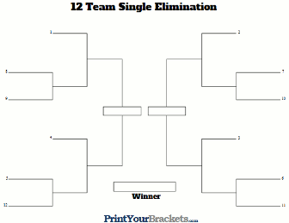
Battle Overview
Battle Dates: Wednesday, February 7th - Friday, February 9^{th.} Battles will start at 9am.
Pool Play ----> Bracket Battles----> Championship Battle
Pool Play: Each team will compete in at least 3 battles over the first 2 days, total points (not wins) determines bracket placement
Bracket Battles: 12 teams in the final bracket battles on Friday, tie-breaker rounds if necessary.
Championship Battle: Top 2 teams, winner advances to Regional Battle at Thurston High School on March 9th
No steals in the Pool Play rounds, but they will be allowed in the bracket and championship battles.

Slide 4
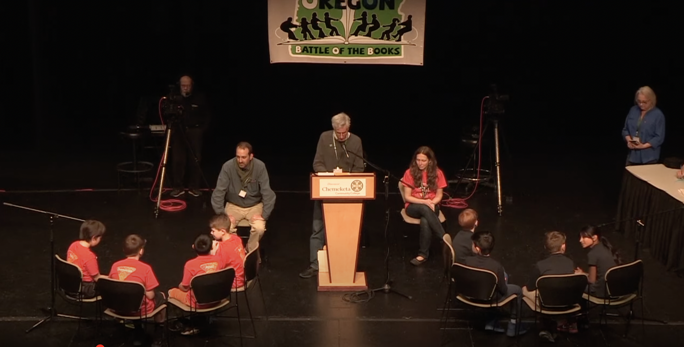
Battle Setup
Two teams made up of 2-4 people compete in a battle. If a team has a 5th team member, that individual needs to sit apart from their team and where they can’t communicate with the them
One Spokesperson—the ONLY person to speak for the team
Moderator (person delivering the questions), final call
Timekeeper/Scorekeeper
Ask the teams if they’re happy with their seats or flip a coin to decide who will be the even team and the odd team
The team receiving the odd numbered questions sits to the left of the moderator and the team receiving the even numbered questions sit on the moderator’s right.

Slide 5
Battle Setup
Fill in team names on the scoresheet before the battle starts
Each battle has 16 questions:
  8 “In which book” questions: answered with the title and
  author of each book
  8 content questions that start with the book title
    Example: “In the book, The Lion of Mars by Jennifer L. Holm, what color was…”
Each question is worth 5 points
  Split points by 3/2

Slide 6
Battle Officials
Moderator
Scorekeeper
Timekeeper
Runners
Command Center

Slide 7
Battle Officials and Battle Progression
Moderator:
Read through your question set before the battle starts.
The Moderator will start each question by calling the team by name.
  Example: “Question #2 goes to The Roaring Readers. In which book…”
Write down their incorrect answers in case they challenge later.
Timekeeper/Scorekeeper:
  Timing starts immediately after the question has been read. Teams will have 15 SECONDS to quietly discuss the question among themselves. At the end of the 15 seconds, the Timekeeper says “TIME” and the spokesperson must answer immediately. Use the stopwatch on your phone.
Moderator and Timekeeper/ Scorekeeper should be checking with each other throughout the battle.

Slide 8
Battle Officials and Battle Progression
Runner
  The runner collects the kids for battles.
  You will have a card with each team member and their homeroom. There will also be a master schedule so you can find where the kids are throughout the day.
  Ask the kids to make sure they know who their spokesperson will be and which teammate is sitting out, if they have a 5th team member.
  Remind the kids to whisper in the library and to be quiet throughout the battles until everyone is done.
  We will take a picture of each team as they come in for their first battle.

Slide 9
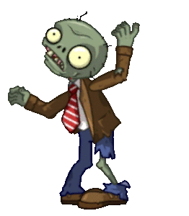
Battle Progression
Use simple, unbiased language and tone. You’re a zombie for the sake of fairness.
If the spokesperson answers incorrectly, the Moderator says “Incorrect.” If it’s correct say, “Correct.”
If the team hasn’t answered at the end of the time, the Moderator should say something like, “Roaring Readers, we need an answer.” Give them about 2 beats to respond. Then you have to say, ”Incorrect” and move on.
https://youtube.com/clip/UgkxY81Ghq96NNZH9e7BFNv_V00C-arEux6I

Slide 10
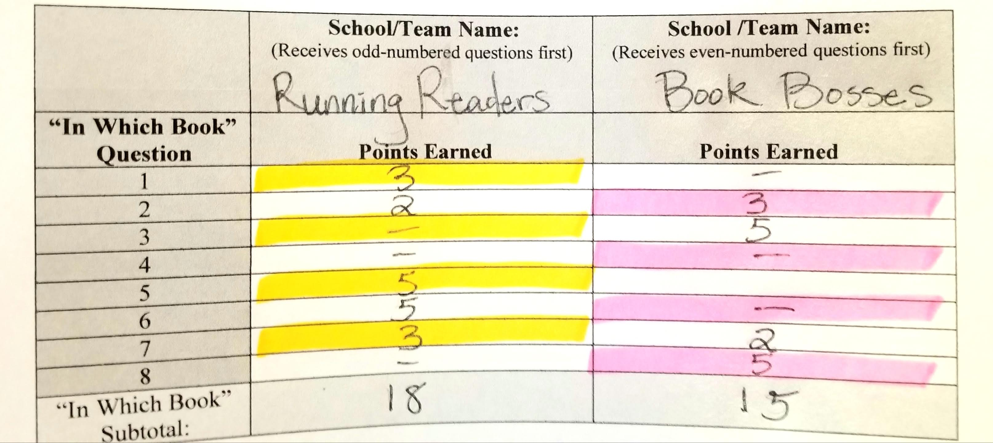
”In Which Book” Questions
All of the “In Which Book” questions are answered with the title of the book and the author(s).
The names of the authors need to be pronounced in a way that is easily understood.
  Example: Tracey Baptiste
If the team only answers one of those correctly, they receive 3 points.
When steals are allowed, the opposing team can pick up the other 2 points. If the team that started with the question can’t answer either the title or the author correctly, then the opposing team can earn 5 points if they answer both correctly. If the opposing team gets only the title or author correct, then they earn 3 points. It’s the first correct answer that gets the 3 points.

Slide 11
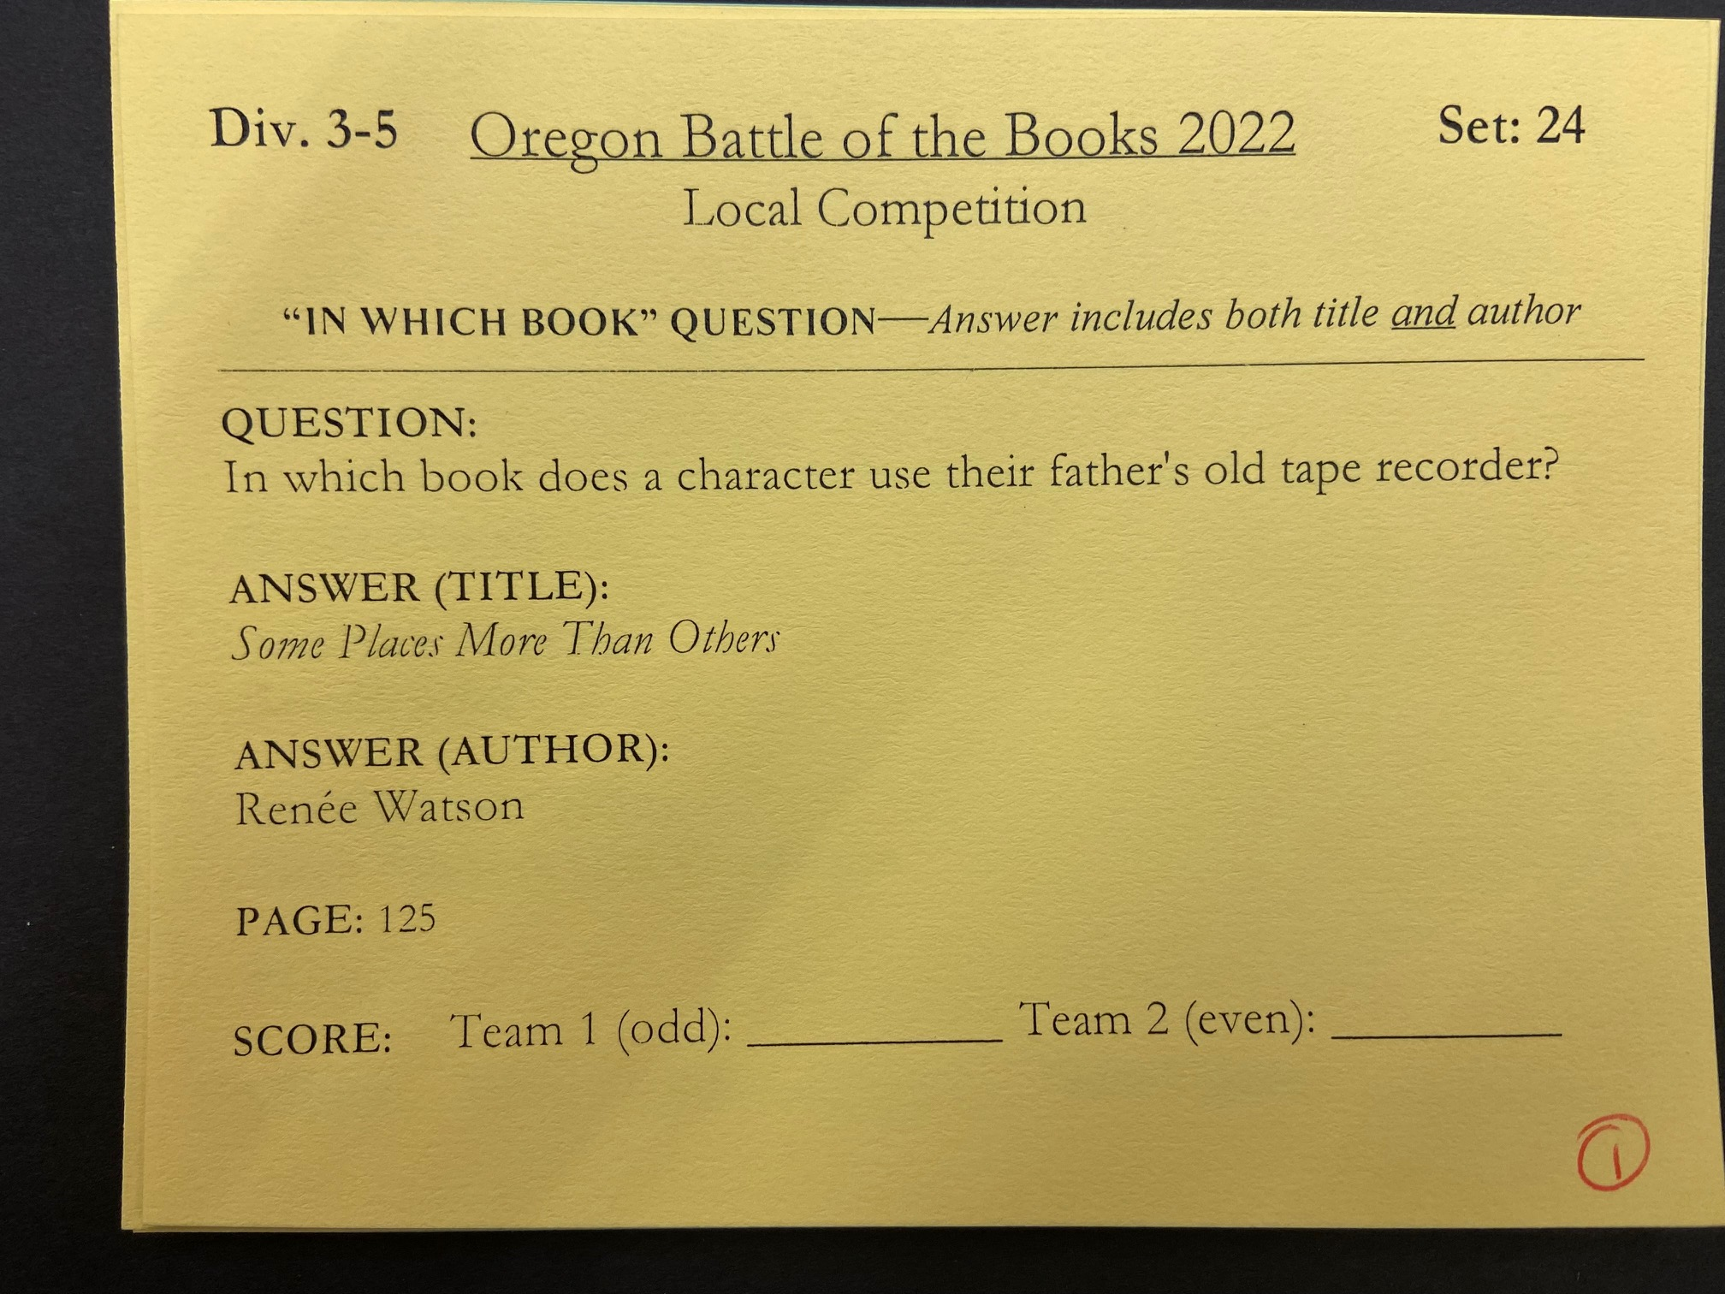

Slide 12
Content Questions
Parentheses – not a required part of answer
  Example: Q: What color are Jennifer’s eyes? A: (light) blue
Underlined = required part of answer
  Example: Q: What magical creature eats clothes off of clothes lines? A: Invisible salamander
“OR” = multiple correct answers
  Example: Q: Who gives Sarah a Lord of the Rings backpack? A: Her mom OR Mrs. Smith
Preface two-part questions with “Raging Readers, this is a two-part question. How many…”
If they only get one answer right, the team earns 3 points. When there is the chance for steals, the other team can pick up the remaining 2 points by delivering the 2nd answer.

Slide 13
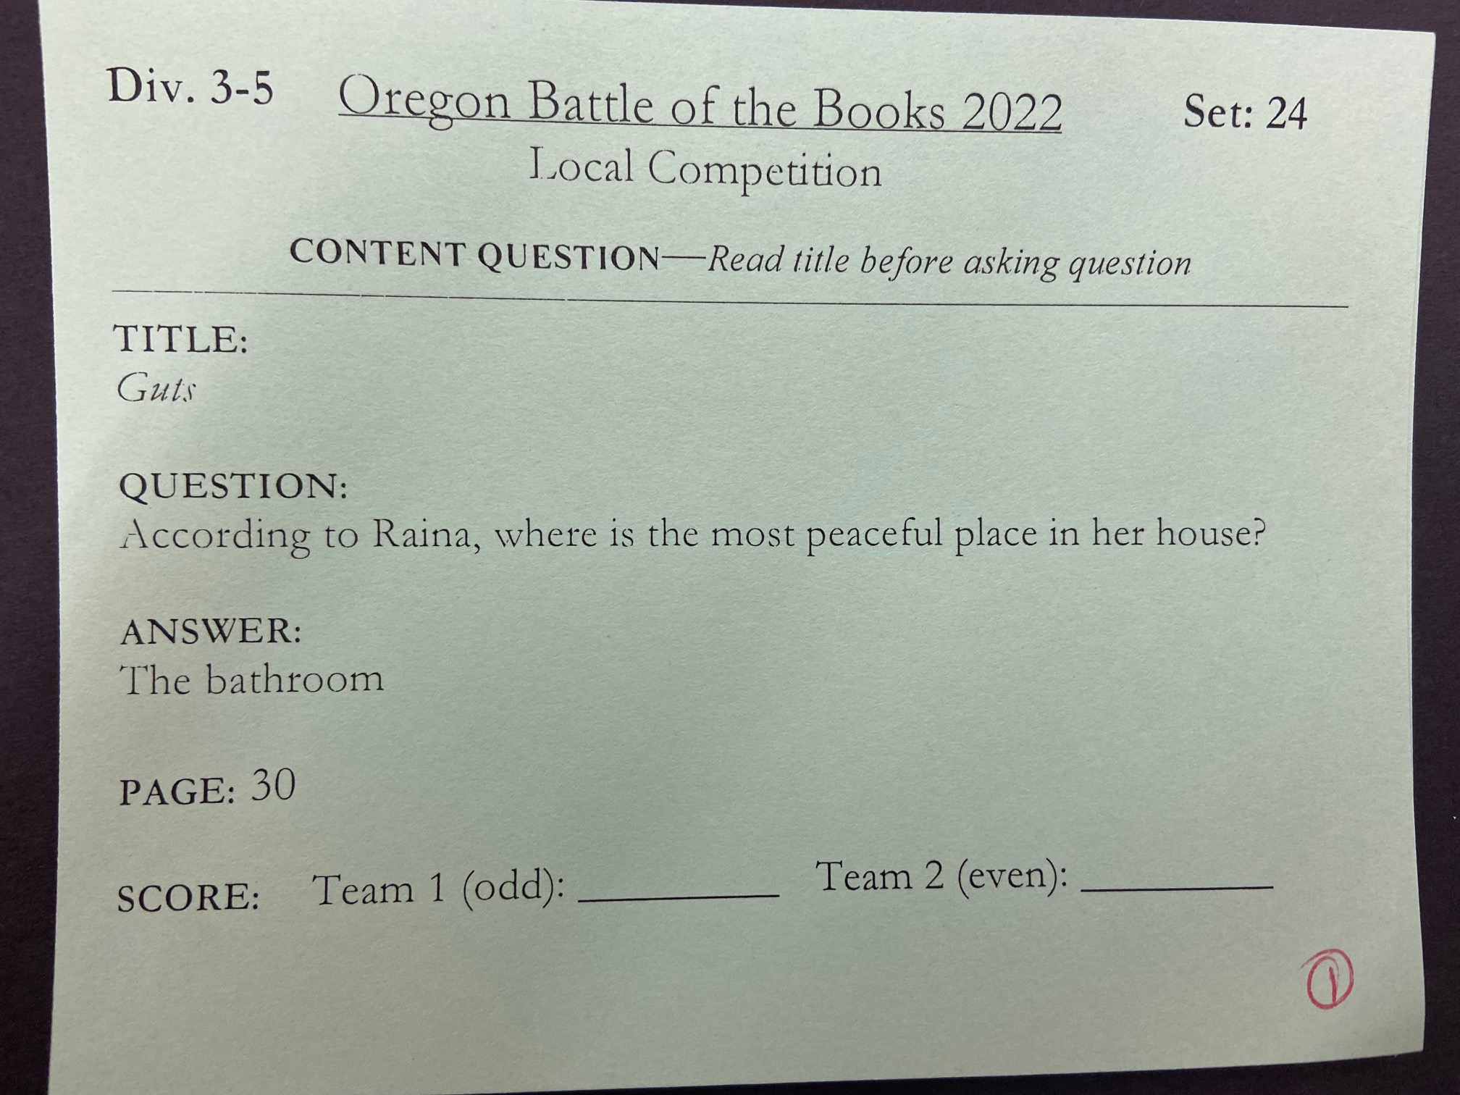

Slide 14
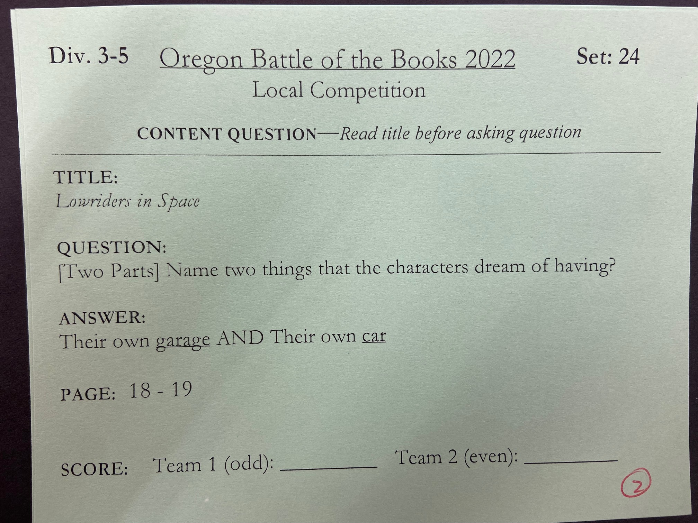

Slide 15
End of the Battle
At the end of the battle the Timekeeper/ Scorekeeper tells each team their score and asks if they want to challenge any questions they were asked.
If they don’t challenge any questions, have each Spokesperson sign under their team’s score.
Encourage good sportsmanship. High fives or fist bumps between each other and the opposing team are great options.
Keep the kids at their table until all the battles for that session are done. Then the kids can head back to class. We will summon their team when it’s time for their next battle.
Remind them that they shouldn’t discuss the questions and answers from the battles.

Slide 16
Challenges
Challenges
The teams can only challenge 1 question that THEY WERE ASKED and they have 15 seconds to decide whether or not to challenge.
The teams can’t seek guidance from anyone else
Make note of the question they want to challenge on the scoresheet.
When the scoresheet is delivered to Command Center, the team will be given 2 copies of the book and they have 2 minutes to find proof that they were correct.
The Spokesperson shows the Command Center personnel the evidence they found in the book.
Points are adjusted accordingly by the Command Center.

Slide 17
Tie-Breakers
We may need to do one at the end of pool-play to determine bracket placement.
In the event of a tied score during bracket battles, we will need to do a tie-breaker to determine who advances.
Each team will be asked an “In Which Book” question and a “Content” question until a winner is identified.

Slide 18
Details
Points will be nullified if:
  Other team members talk while the spokesperson is answering
  Anyone prompts the spokesperson while answering
  Anyone other that the spokesperson answers after the time is called
An answer must be given immediately if any team member interrupts the moderator as they’re reading the question
A team can request that the question be asked again, but the timer keeps running
We have a few question sets set aside in case a question is botched.
No videos or pictures of the battles
Don’t tell kids who they’re battling ahead of time.

Slide 19

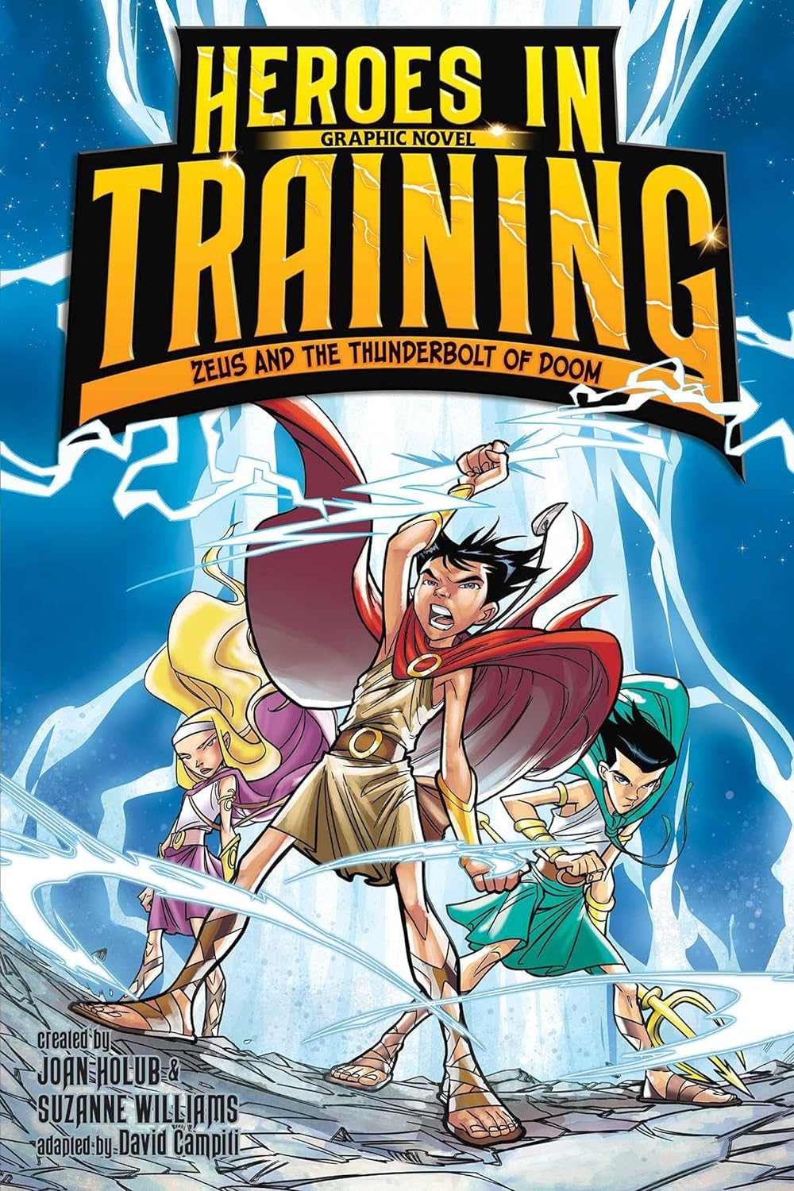
Details
NO SERIES TITLES!
  Heartwood Hotel: A True Home= Incorrect
  A True Home= Correct
  Heroes in Training: Zeus and the Thunderbolt of Doom= Incorrect
  Zeus and the Thunderbolt of Doom= Correct
Can omit “A/An/The” from beginnings of titles
  The Lion of Mars= Correct
  Lion of Mars= Also Correct
  When You Trap the Tiger= Incorrect
  (wrong article in the middle of the title)

Slide 20
Resources
OBOB Handbook/Rules:
  https://www.oregonbattleofthebooks.org/wp-content/uploads/2023/01/obob-Handbook-2022-23.pdf
Basic Rules:
  https://docs.google.com/document/d/1_Xca-btTQRcuL0GpjEjXxTlzwgq9NOVOy9sA24gXyOc/edit
Pronunciation Guide:
  https://www.wccls.org/sites/default/files/OBOB/2023-2024%20author%20pronunciation%203-5.pdf
OBOB Website:
  https://www.oregonbattleofthebooks.org/

Slide 21
Thank you for OBOBing with us!
Questions?

